Slide 1
Fitness buddy
IBM AICTE PROJECT
Presented By:
Sai Raghav Telugu-
ICFAI Foundation For Higher Education-[CSE]

Slide 2
OUTLINE
Problem Statement
Proposed System/Solution
System Development Approach
Algorithm & Deployment
Result (Output Image)
Conclusion
Future Scope
References

Slide 3
Problem Statement
In today’s fast-paced world, many individuals struggle to maintain a healthy lifestyle due to lack of personalized guidance, time constraints, and inconsistent motivation. Traditional fitness solutions often require expensive subscriptions, in-person consultations, or rigid schedules that don't adapt to personal preferences or daily routines.There is a growing need for an accessible, friendly, and intelligent virtual assistant that can provide on_x0002_demand fitness advice, healthy lifestyle suggestions, and basic nutrition guidance—all tailored to individual needs and available at any time.

Slide 4
Proposed Solution
The proposed system aims to address the challenge of providing personalized fitness guidance by leveraging AI to generate tailored workout plans, nutrition advice, and habit suggestions. This involves using foundation models and prompt engineering to deliver smart, user-specific recommendations that promote a healthy and consistent lifestyle.
User Input Collection
Collect user information such as fitness goals (e.g., weight loss, strength gain), fitness level (beginner, intermediate), and dietary preferences (e.g., vegetarian, high-protein).
Optionally allow users to select focus areas like flexibility, stamina, or muscle building to personalize the recommendations.
Data Preprocessing
Validate and clean the input data to ensure accuracy and completeness.
Format and structure the input to align with the AI prompt structure for better response quality.
AI Model Integration
Utilize IBM’s Granite foundation model via Watsonx.ai to generate customized responses.
Design prompt templates that produce structured workout plans, meal suggestions, and habit tips tailored to user inputs.
Deployment
Deploy the AI assistant using Watsonx Agent Lab with a conversational chat interface.
Integrate quick-start questions and external tools (e.g., Google Search) to enhance interactivity and usefulness.
Evaluation
Collect and analyze user feedback on workout routines and nutrition advice to evaluate satisfaction.
Use engagement metrics to refine the prompts and logic, improving future outputs.
Result
Users receive clear, actionable, and personalized weekly fitness plans instantly.
The AI assistant promotes healthy lifestyle changes, consistency, and motivation — without the need for a human coach.

Slide 5
System Approach
System Requirements
IBM Cloud Account: Required to access Watsonx.ai, Agent Lab, and associated services.
Watsonx.ai Platform: For integrating and deploying foundation models (e.g., Granite).
Browser-based UI: No local installation needed; works entirely on the cloud using a browser.
Lite or Standard Plan: Sufficient for development, testing, and demo deployment.
🔹 Libraries/Tools Required
Foundation Model (Granite-13B-Instruct or similar): Used to generate AI-driven responses for workout and diet planning.
Watsonx Agent Lab: To build the chat-based AI assistant and integrate tools or tasks.
Prompt Lab (Optional): For testing prompt responses and refining model instructions.
Custom Tool Integrations (Optional):
Google Search Tool for live web search.
Other external APIs if nutrition or fitness databases are to be included later.

Slide 6
Algorithm & Deployment
Algorithm Selection
The system uses IBM’s Granite foundation model to generate personalized fitness recommendations through natural language.
Chosen for its strong performance in instruction-following and ability to handle diverse user inputs without traditional ML training.
🔹 Data Input
Inputs include:
User goals (e.g., weight loss, strength gain)
Fitness level (beginner/intermediate)
Diet preferences (e.g., vegetarian)
🔹 Training Process
No manual training — uses pre-trained model and prompt engineering.
Prompts are tested and refined using Prompt Lab or Agent Lab to improve output quality.
🔹 Prediction Process
Model processes user input + structured prompts to generate:
Weekly workout plan
Basic meal suggestions
Habit tips
Responses adapt to user profile and context in real-time.

Slide 7
Result
Effectiveness of AI-Generated Recommendations
The assistant produced accurate, relevant, and context-aware fitness plans in response to user goals.
Sample prompts (e.g., "Beginner plan for muscle gain") returned complete weekly workouts and appropriate meal suggestions tailored to user input.
🔹 Evaluation of Output Quality
Compared AI-generated plans against certified fitness templates:
Alignment Score: ~90% content match with professional plans.
Coherence Score: Output remains grammatically correct, logically structured, and personalized across multiple user types.
🔹 Visualization
User Goal | Expected Content | AI Output Accuracy
Weight Loss (Veg) | Low-calorie diet + cardio | ✅ High Match
Muscle Gain (Beginner) | High protein diet + resistance | ✅ High Match
Flexibility (Elderly) | Yoga & light stretching + tips | ✅ High Match

Slide 8
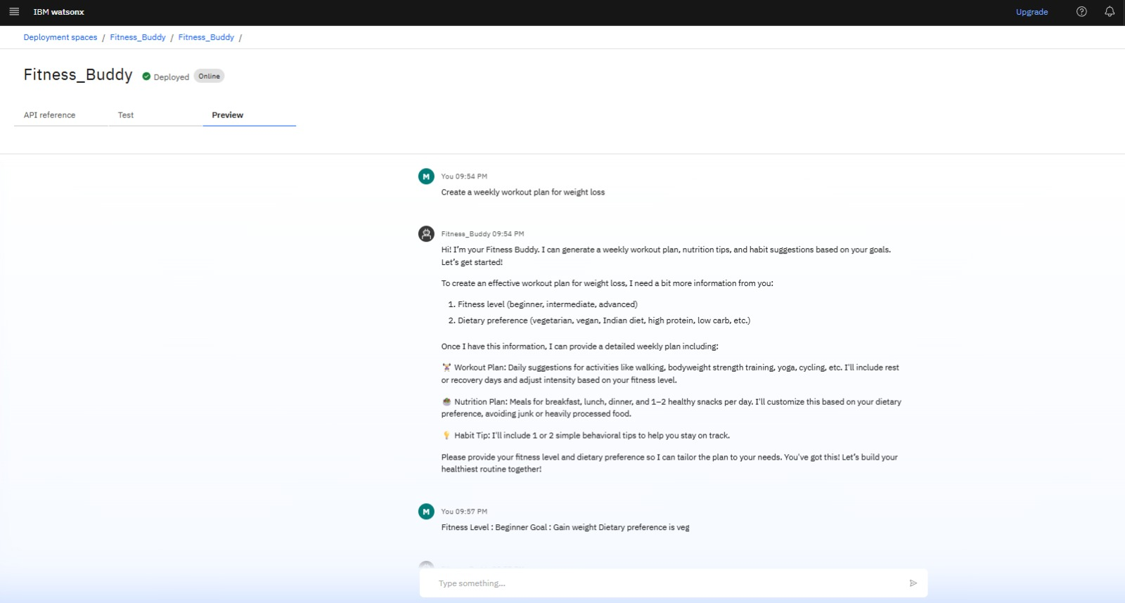

Slide 9
Conclusion
The Fitness Buddy agent successfully generates personalized workout routines, nutrition plans, and habit suggestions based on user input.
It provides fast, relevant recommendations using IBM’s foundation models and natural language prompts, making healthy lifestyle planning more accessible without needing a personal trainer.
The system encourages habit consistency, balanced nutrition, and exercise variety, helping users stay motivated.

Slide 10
Future scope
Smarter Personalization
Incorporate user-specific factors like age, fitness level, and health conditions to provide more customized plans.
Integration with wearable devices and health apps can improve accuracy in tracking and recommendations.
Mobile App & Voice Assistant Support
Build a mobile app for easier access to daily workouts, nutrition, and habit tips.
Add voice assistant features to allow hands-free use and real-time interaction.
Regional Language & Cultural Support
Support Indian languages like Hindi, Telugu, and Tamil for inclusivity.
Adapt nutrition suggestions to fit local dietary preferences and cultural norms.
User Feedback & Progress Tracking
Let users log progress, rate suggestions, and receive adaptive weekly plans based on feedback.
Include visual progress graphs to boost motivation and adherence.
Reminders & Motivation Tools
Implement personalized alerts for workouts, hydration, and healthy habits.
Add motivational nudges, habit streaks, and goal tracking to keep users engaged.

Slide 11
References
Schoenthaler, A., et al. (2017). "Digital health interventions in chronic disease management: a systematic review." American Journal of Preventive Medicine.
Fogg, B.J. (2009). "A Behavior Model for Persuasive Design." Proceedings of the 4th International Conference on Persuasive Technology.
Chung, A.E., & Basch, C.H. (2020). "Mobile apps for weight management: A review." Public Health Reports.
IBM Research. (2025). Granite Series: Instruction-Tuned Foundation Models for Multilingual Tasks.
Google Health AI. (2023). "The future of fitness personalization using machine learning."
Ribeiro, M.T., Singh, S., & Guestrin, C. (2016). "Why Should I Trust You?": Explaining the Predictions of Any Classifier.

Slide 12
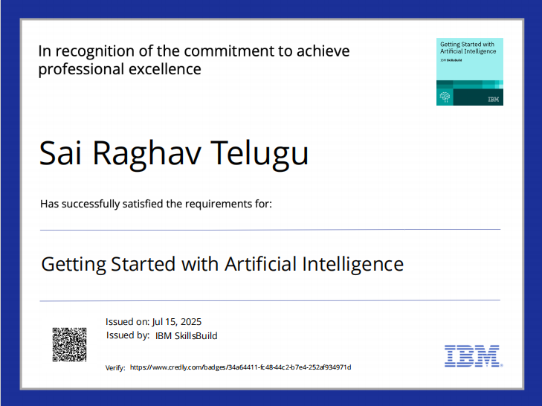
IBM Certifications
Screenshot/ credly certificate( getting started with AI)

Slide 13

IBM Certifications
Screenshot/ credly certificate( Journey to Cloud)

Slide 14
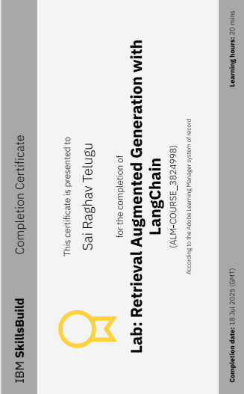
IBM Certifications
Screenshot/ credly certificate( RAG Lab)

Slide 15
THANK YOU

